Slide 1
CLASS-VI
SUBECT-SCIENCE

Slide 2
CHAPTER-07 GETTING TO KNOW PLANTS
PRESENTED BY
SUDHIR KUMAR SINGH
D.I.E.T
RUDRAPUR,U.S.NAGAR
U.K.

Slide 3
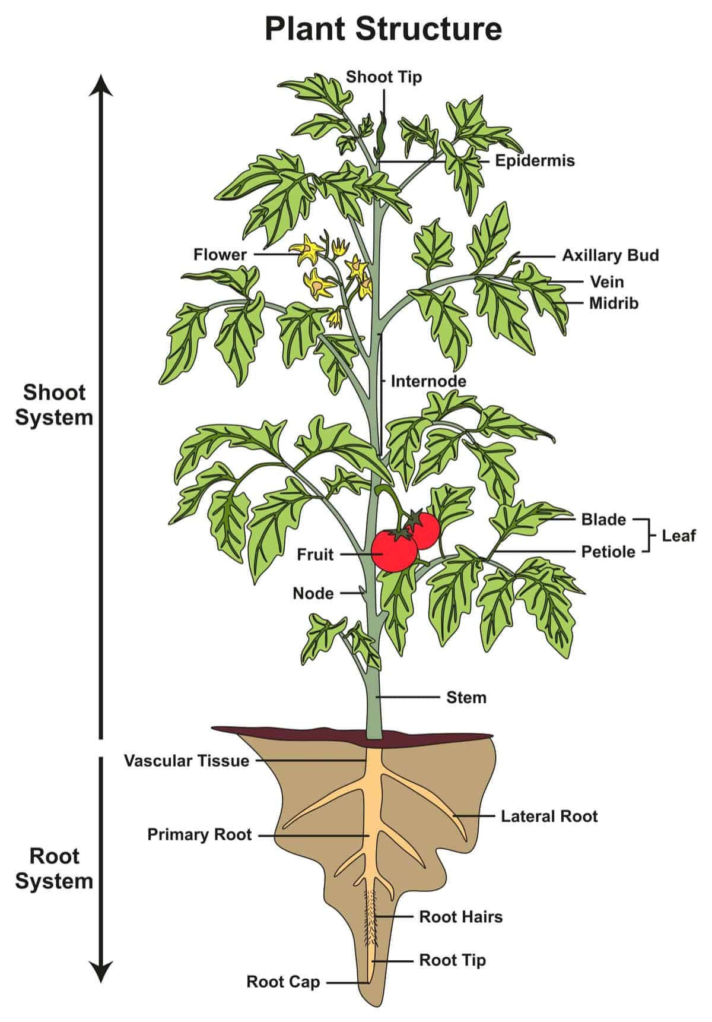
PLANTS
PARTS OF PLANTS
ROOT
STEM
LEAF
FLOWER
FRUIT

Slide 4
TYPES OF PLANTS
On the basis of height , stem and branches plants can be of three types :-
HERBS
SHRUBS
TREES

Slide 5
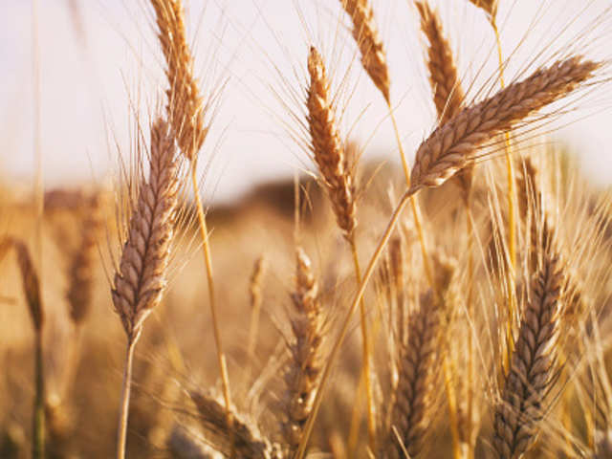
HERBS
Small plant.
Soft stem.
May not have many branches.
Example:- Wheat , Paddy, grass , Cabbage etc.

Slide 6
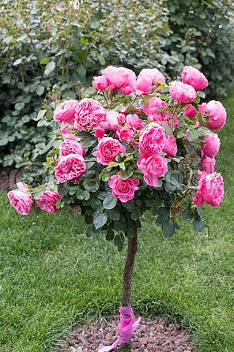
SHRUBS
Bushy & Medium sized plants.
Some what bigger than Herbs.
Branching starts from just about the ground.
Example:- Rose , Henna , Lemon etc.

Slide 7
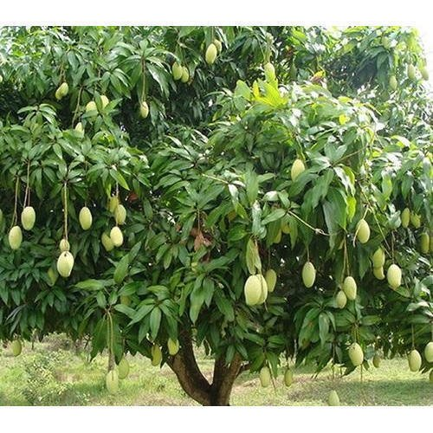
TREES
Tall & large plants.
Hard & woody stem.
Main stem is called TRUNK.
Trunk gives out many branches.
Branches carry leaves , flowers and fruits.
Example:-Mango , Banyan , Coconut etc.

Slide 8
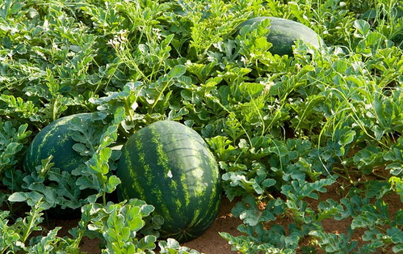
SOME OTHER TYPE OF PLANTS
CREEPERS
Plants with weak stem.
Can not stand upright.
Spread on the ground.
Examples:- Pumpkin , Watermelon , Sweet potato etc.

Slide 9
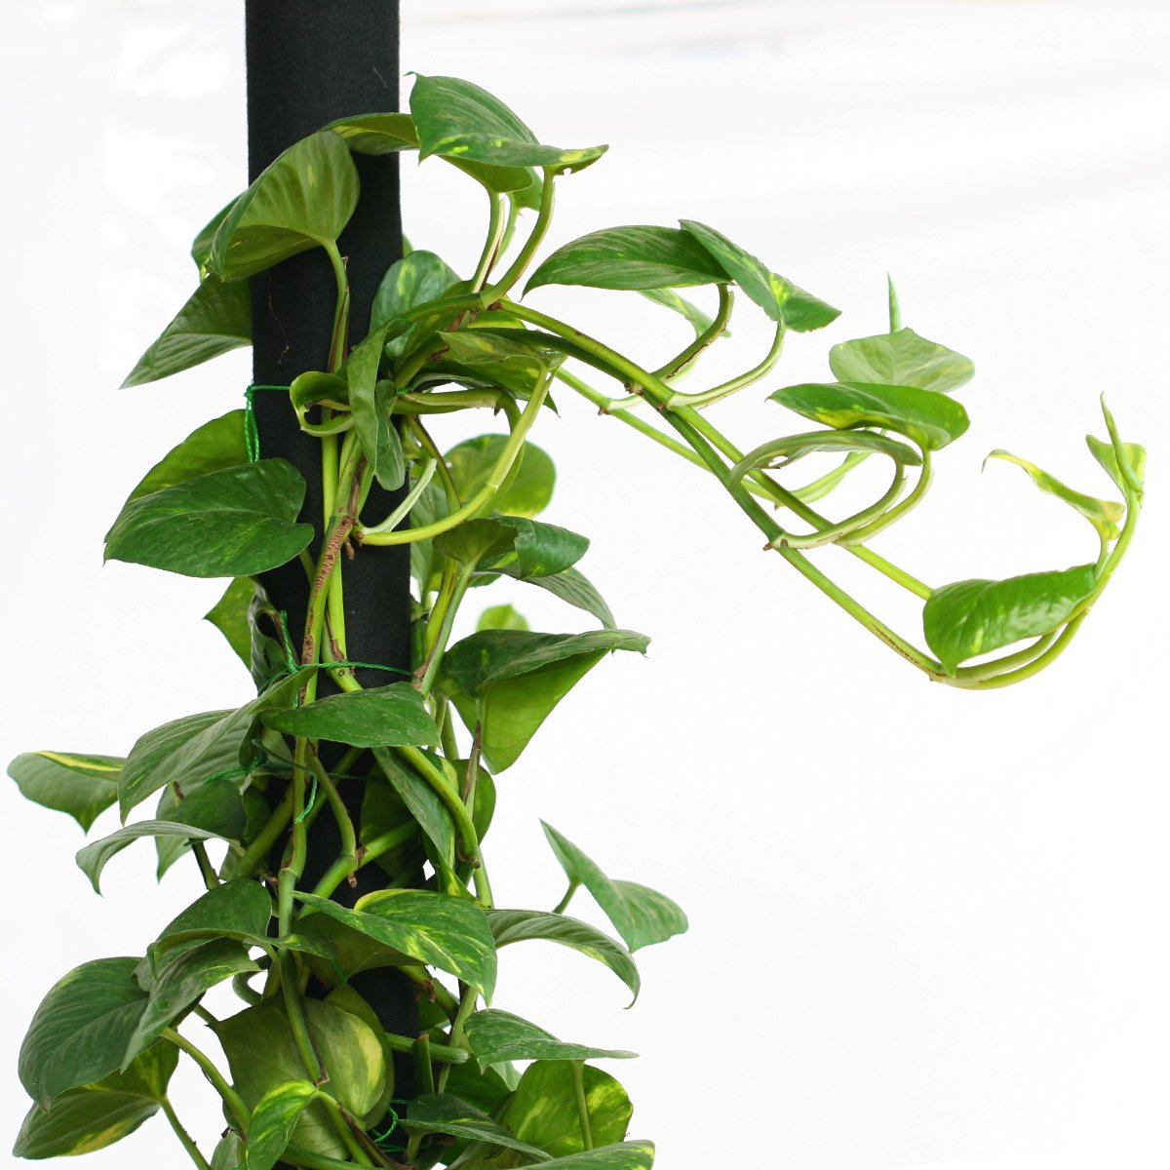
CLIMBERS
Plants with weak stem.
Need support is called climber.
Example:- Money plant , Cucumber bean , etc.

Slide 10
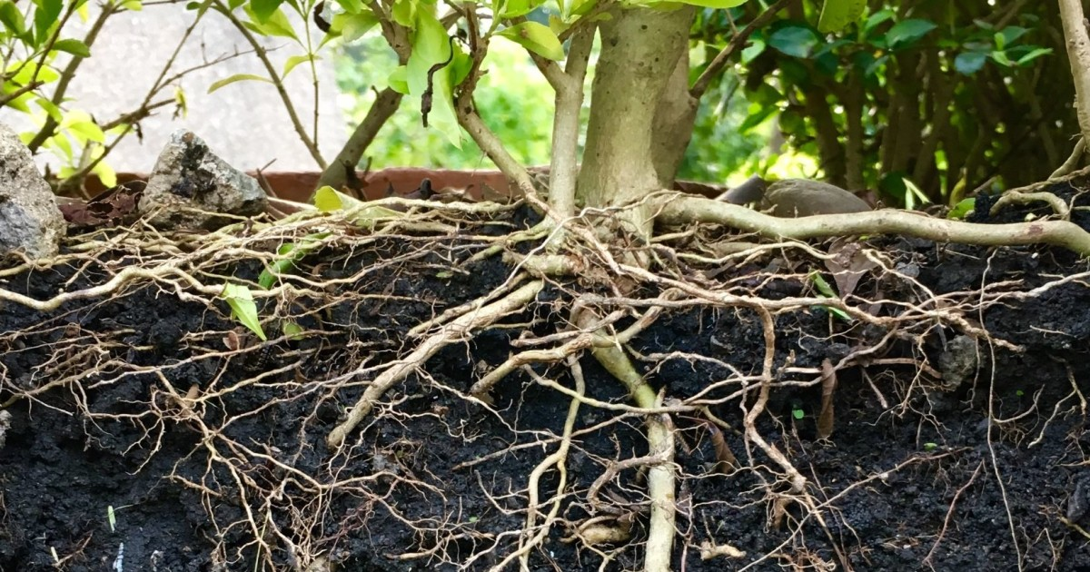
ROOTS
Underground part of a plant.
Usually pale in colour.
Holding the plant firmly in the soil.
Absorb water & mineral from soil.

Slide 11
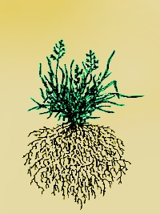
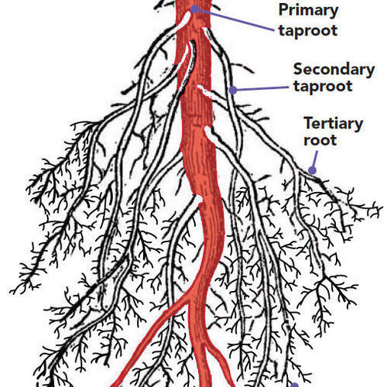
TYPES OF ROOTS
TAP ROOT
FIBROUS ROOT
This is composed of a main root.
Many branches & sub branches come out of the main root(Tap Root).
Example:- Mango , Pea , Carrot , Radish , Mustard etc.
A cluster of thin fiber-like roots.
Arise from the base of the stem.
These roots spread out in the soil.
Example:- Grass , Maize , Wheat , Millet etc.

Slide 12
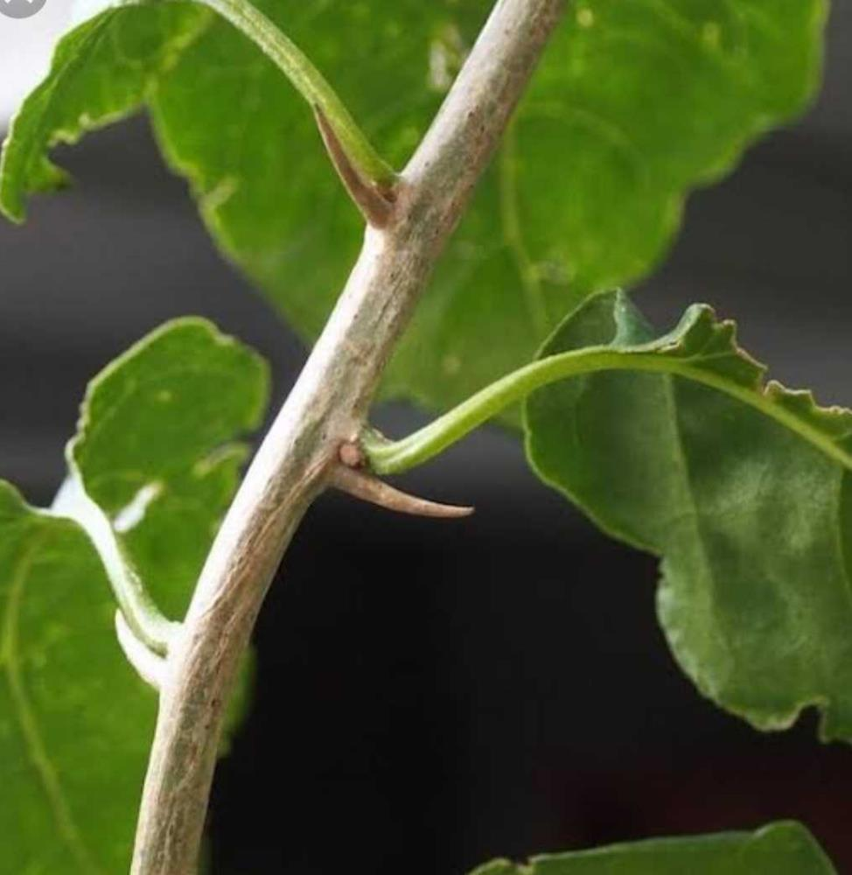
STEM
Stem usually grows above the ground.
Makes the main structural framework of the plants.
Bears leaves , branches , buds ,flowers & fruits.
Node & internode present in the stem.

Slide 13
FUNCTION OF STEM
Stem gives structural support to the plant.
It bears branches , leaves , flowers & fruits.
Carries water & minerals from the roots to different parts of the plant.
Modified for food storage in some plants .
Example:- Potato , Ginger & Turmeric etc.

Slide 14
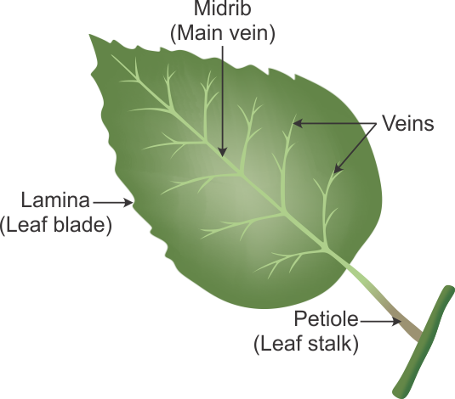
LEAF
Thin , flat & green structure.
Green colour due to CHLOROPHYLL.
Flat green portion of leaf is LAMINA (leaf-blade)
Leaf attached to the stem by a short stalk – PETIOLE
The lines on the leaf – VEINS
Thick , middle vein is MIDRIB
Design in a leaf by veins is LEAF VENATION.

Slide 15
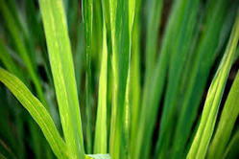
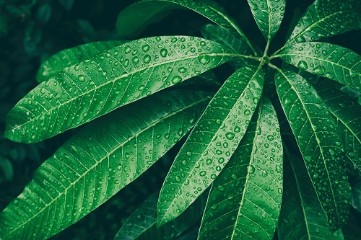
LEAF VENATION
PARALLEL VENATION
RETICULATE VENATION
The veins are parallel to one another in the leaves – parallel venation .
Example:- Grass
If the design is net-like on bothsides of midrib –reticulate venation .
Example:-Mango

Slide 16
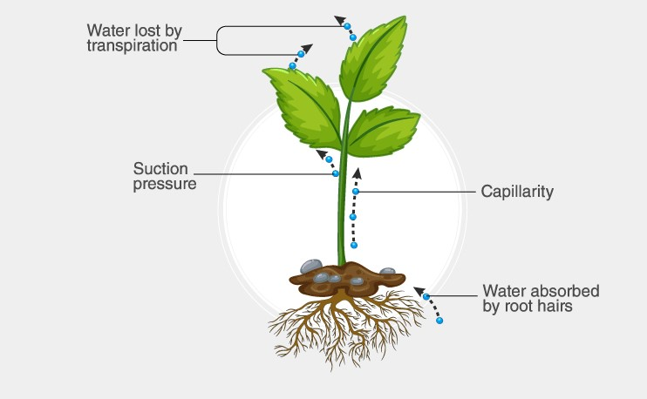
TRANSPIRATION
Water comes out of leaves in the form of vapour by a process called Transpiration.
Plants release a lot of water into the air through this process.

Slide 17
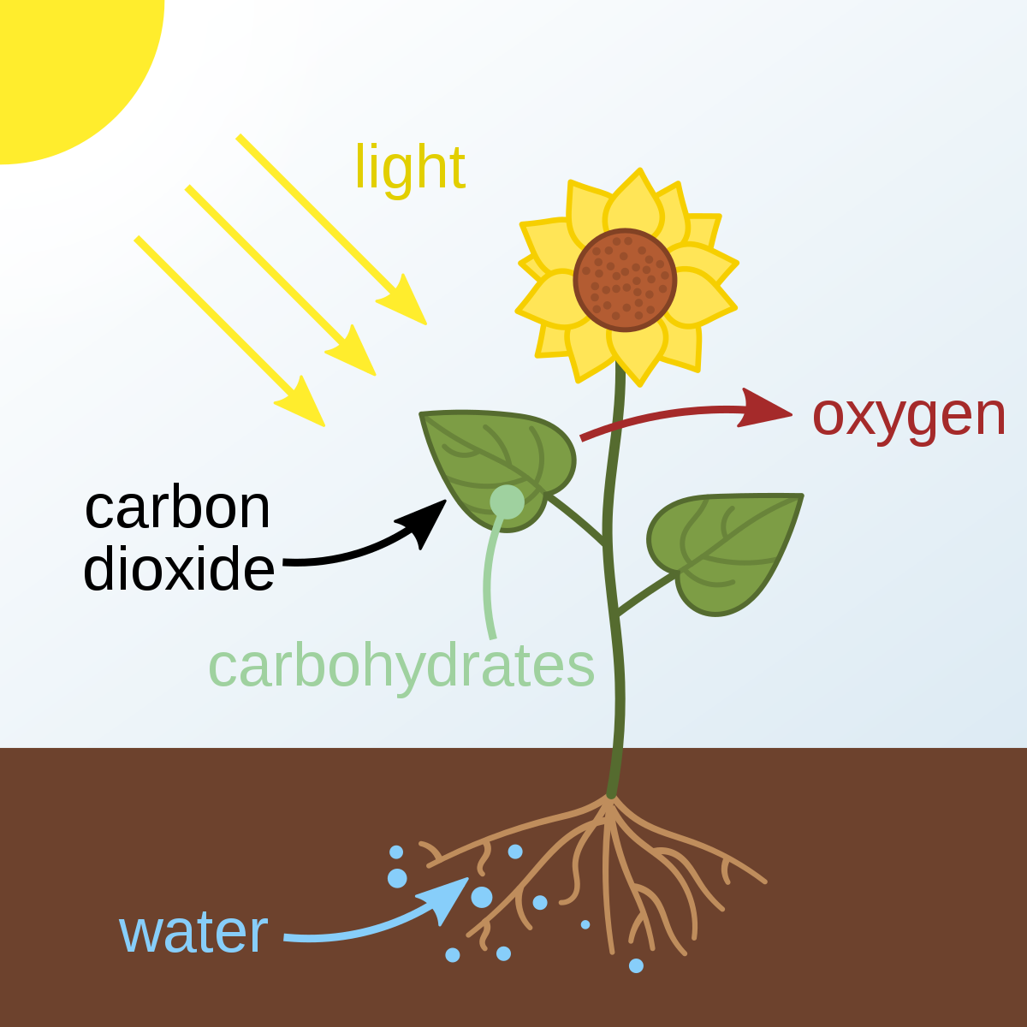
PHOTOSYNTHESIS
Leave prepare food in the presence of sunlight & chlorophyll.
Use water & carbon dioxide from air.
This is called PHOTOSYNTHESIS.
Oxygen is given out in this process.

Slide 18
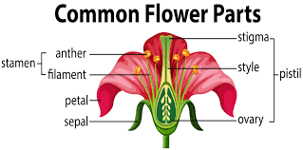
FLOWER
A flower is reproductive part of the plant .
The outer green leafy structure is sepal(calyx-collectively).
The coloured leaf like structures are called petals (corolla-collectively).

Slide 19
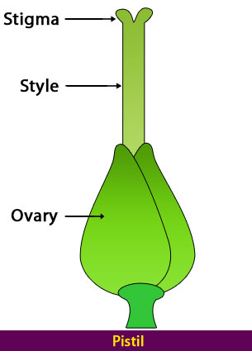
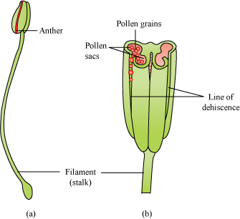
PARTS OF A FLOWER
STAMEN
PISTIL
The STAMEN is the pollen-producing reproductive organ of a flower.
The ovule producing part of a flower is known as the PISTIL

Slide 20
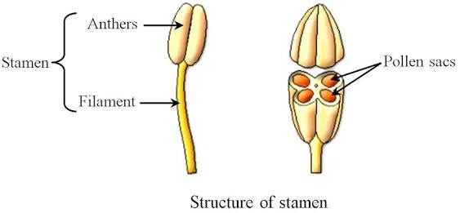
PARTS OF STAMEN
ANTHER :- The part of the stamen where pollen is produced.
FILAMENT :- The filament is a stalk that connects to the anther.

Slide 21
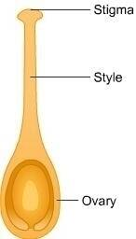
PARTS OF PISTIL
STYLES :- Long , slender stalk that connects the stigma & the ovary.
STIGMA :- Sticky platform at the top of the style where pollen is deposited.
OVARY :- The enlarged basal portion of the pistil where ovules are produced.

Slide 22
EXERCISE
FILL IN THE BLANKS
An example of herb_________.
An example of shrub_________.
An example of tree__________.
An example of climber________.
An example of creeper________.

Slide 23
2. FALSE AND TRUE
Green colour of leaf due to chlorophyll.
Reticulate leaf venation is wheat’s leave.
In photosynthesis oxygen is given out.
Petal are collectively known as calyx.
A flower is reproductive structure.

Slide 24
3.MATCH THE FOLLOWING
A
Anther
Pistil
Root
Leaf
Stem
B
Node & Internode
Transpiration
Pollen grains
Absorbs water
Ovary

Slide 25
THANK YOU

