Slide 1
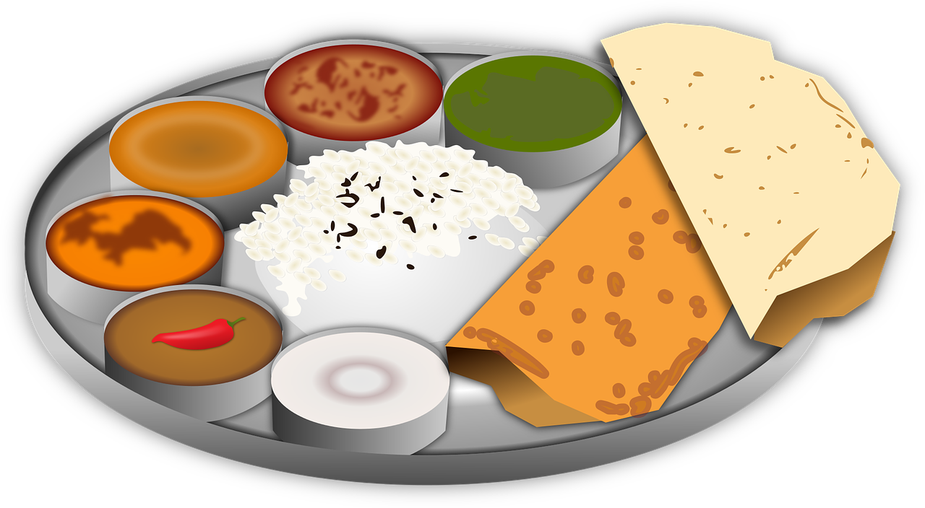
Components of Food
By- Rajnish Mani Pandey
DIET U.S. Nagar

Slide 2
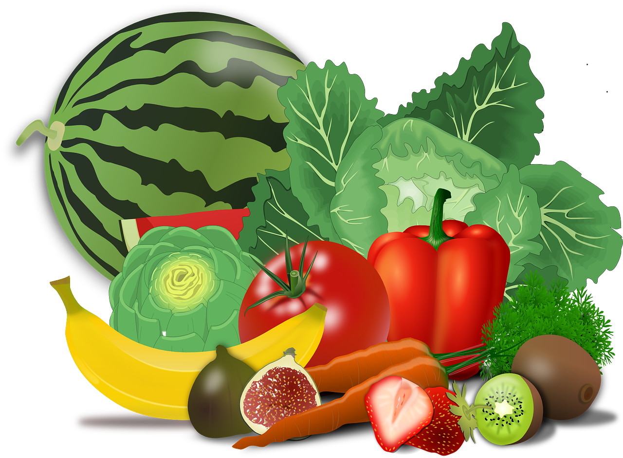
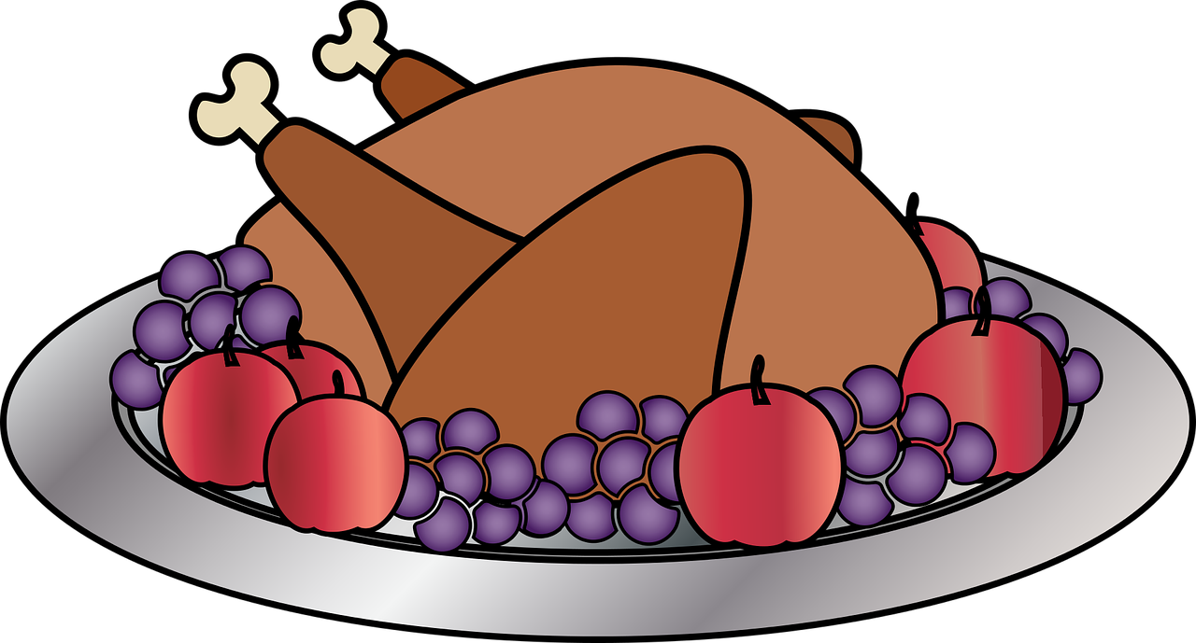
Food
Chinki, Minki and Chintu want to play.
For playing they need Energy
From where they will get energy?
They will get energy from “Food”.

Slide 3
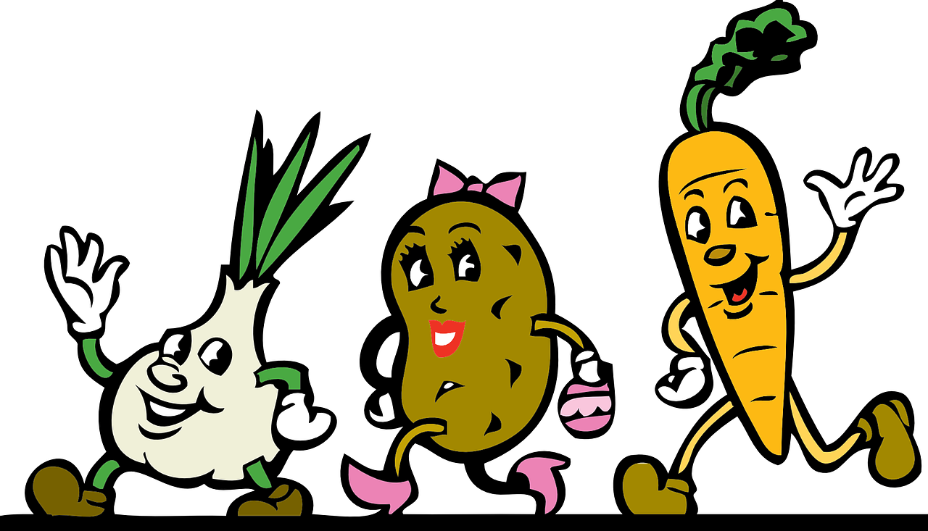
What is food?
Any nutritious substance that people or animal eat or drink to nourish body and maintain growth is known as food.
The main components of food are carbohydrate, vitamins, protein, fats and minerals
These components are known as “nutrients”.

Slide 4
Food components
Carbohydrate
Fat
Protein
Vitamins
Minerals

Slide 5
Carbohydrates
Carbohydrates are also called energy giving food.
It is the main source of energy.
Carbohydrates are made up of carbon, hydrogen and oxygen.
There are three main types of carbohydrates :
1. Sugars
2. Starch
3. cellulose

Slide 6
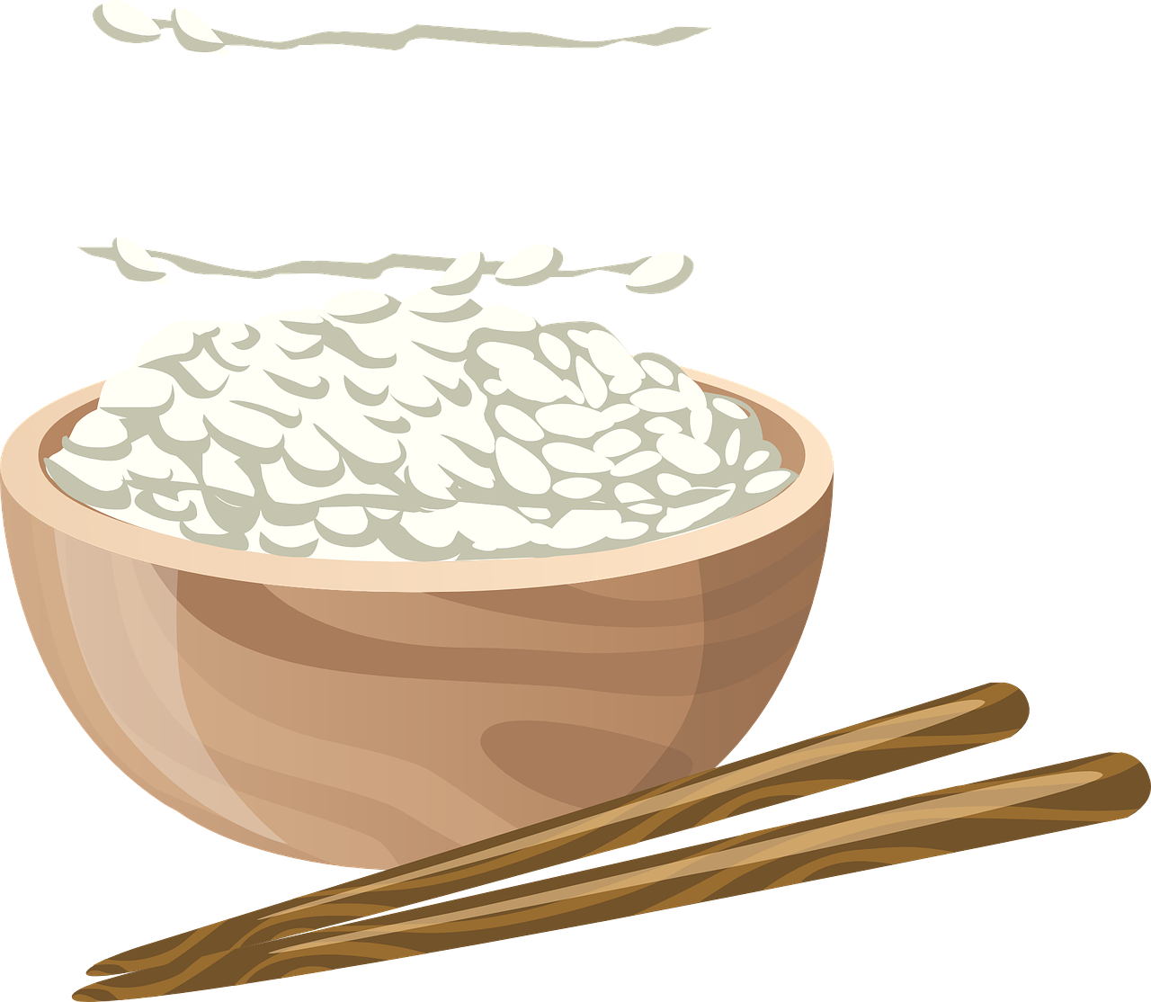
Sources of carbohydrate
Potato
Sugarcane
Banana
Rice
Wheat
Maize

Slide 7
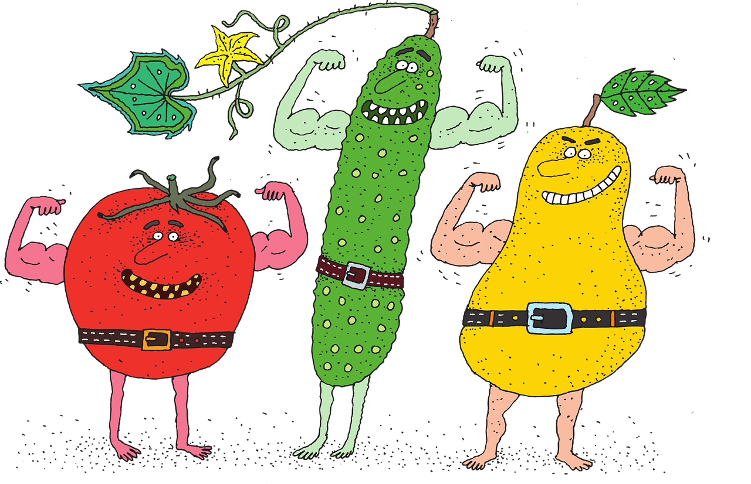
Protein
Protein is also known as body building food.
It helps in growth of body.
It repairs damaged tissues.
Protein molecule is made up of a large number of small molecules called amino acids.
Growing children need more protein in their diet for their body growth.

Slide 8
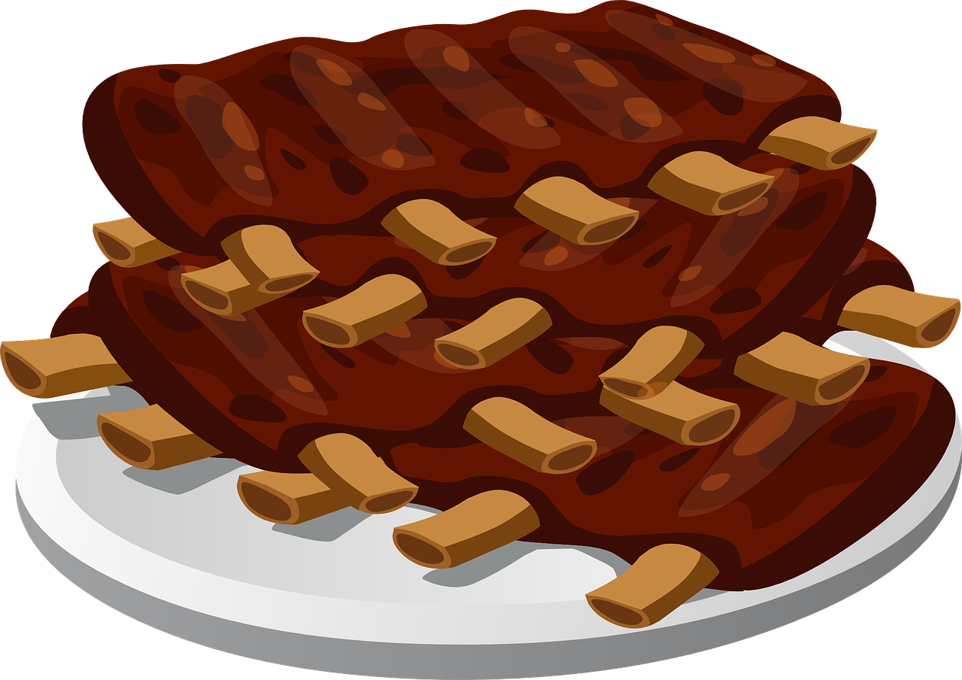
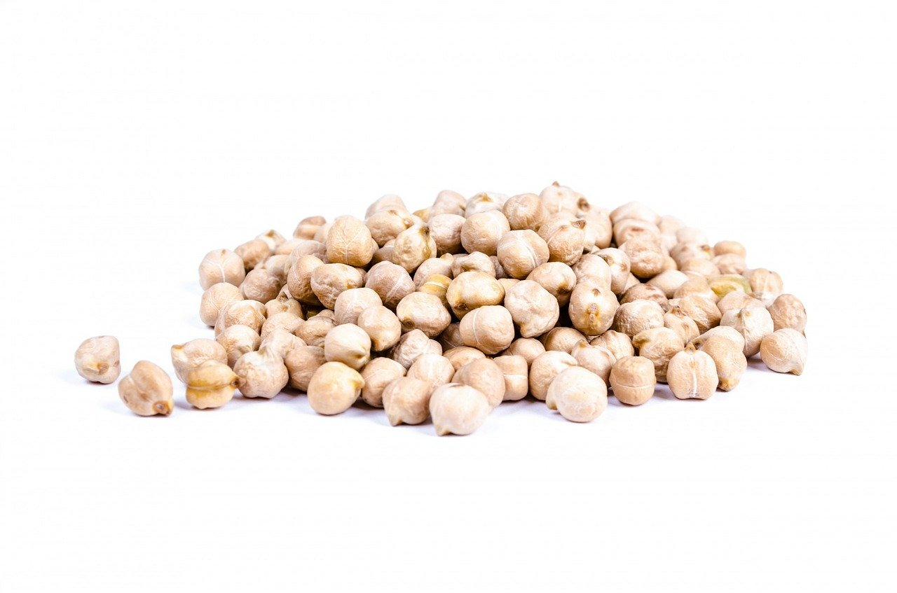
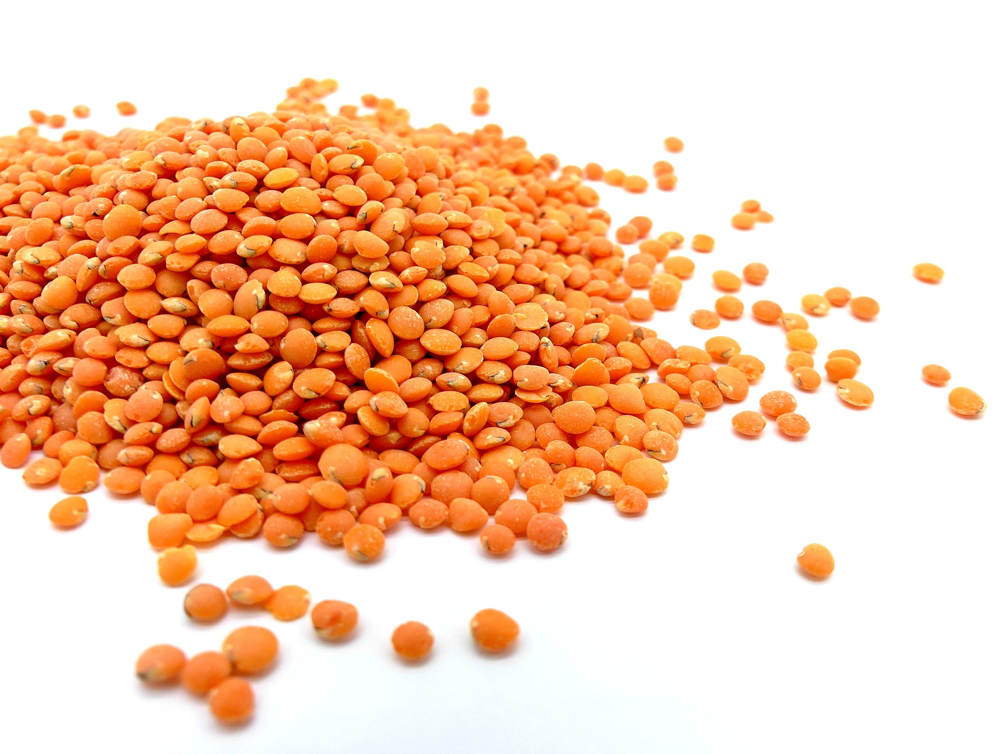
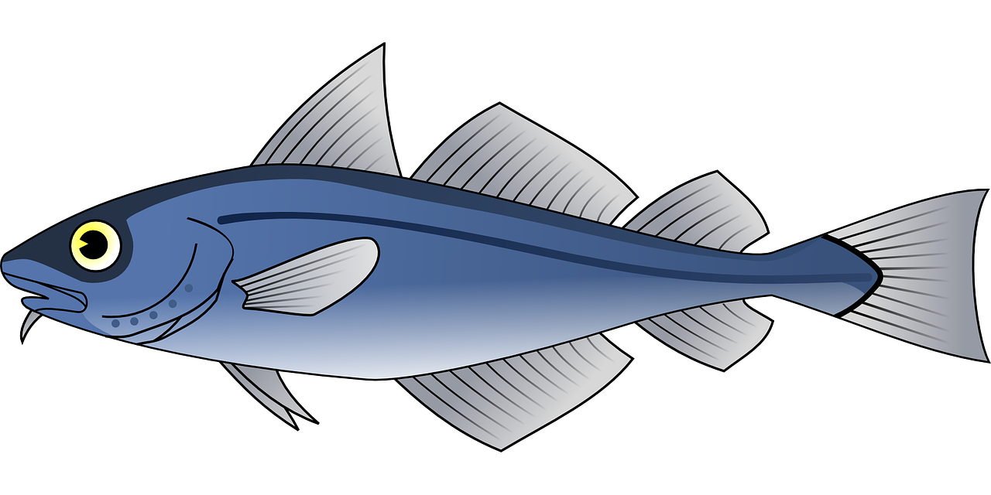
Sources of protein
Milk
Eggs
Pulses
Meat
Fish

Slide 9
Fat
Our body stores excess energy in the form of fats.
Stored fat is used by body for producing energy when needed.
Fat is also known as energy bank of our body.
Fats are also essential for absorption of vitamins in our body.
Fats also help to prevent heat loss from our body.

Slide 10
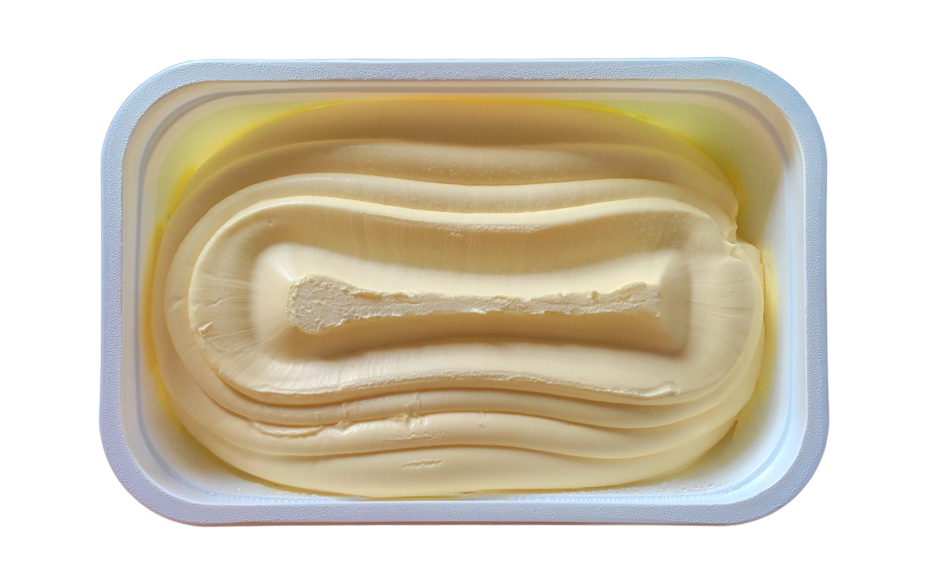
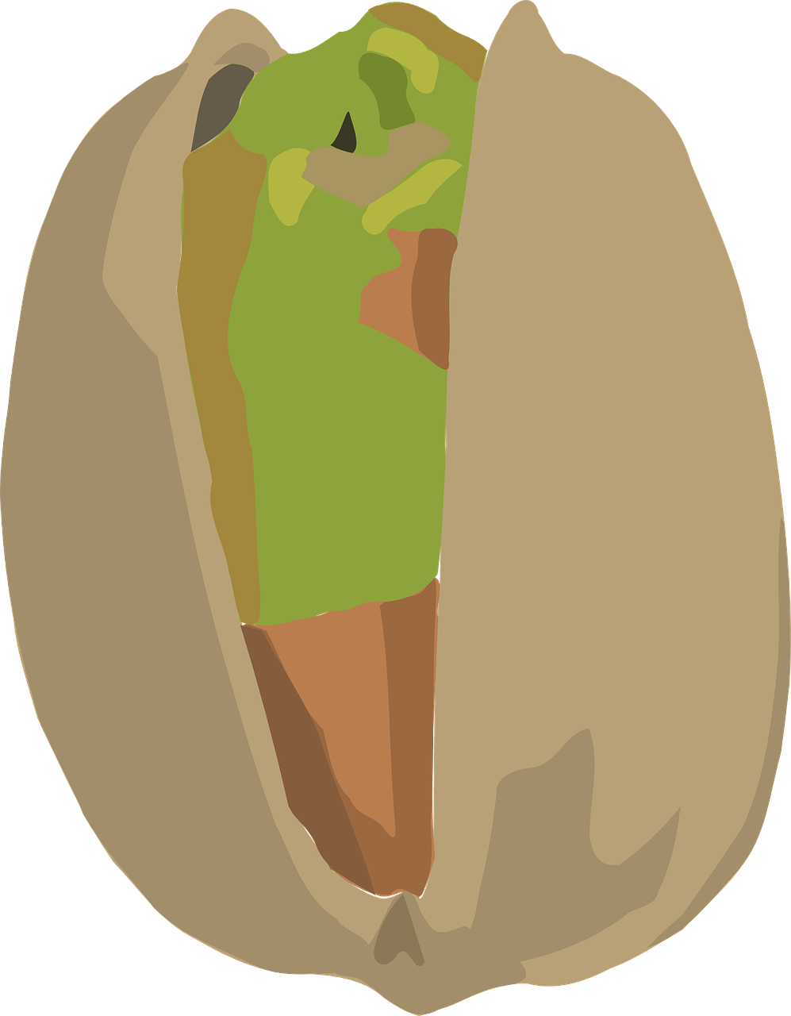
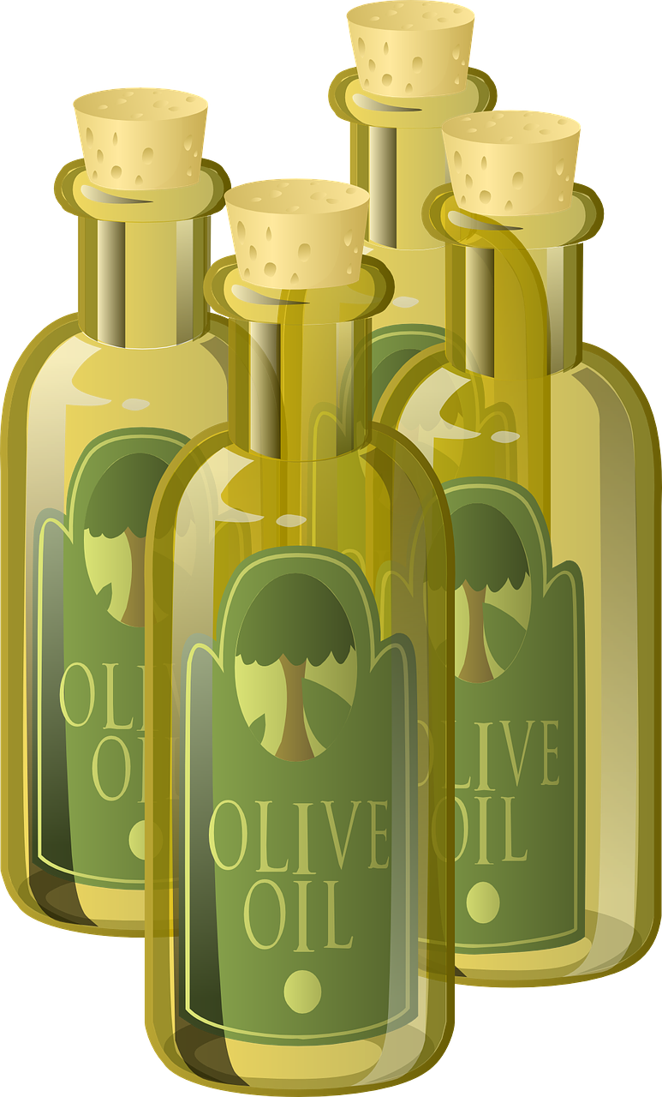
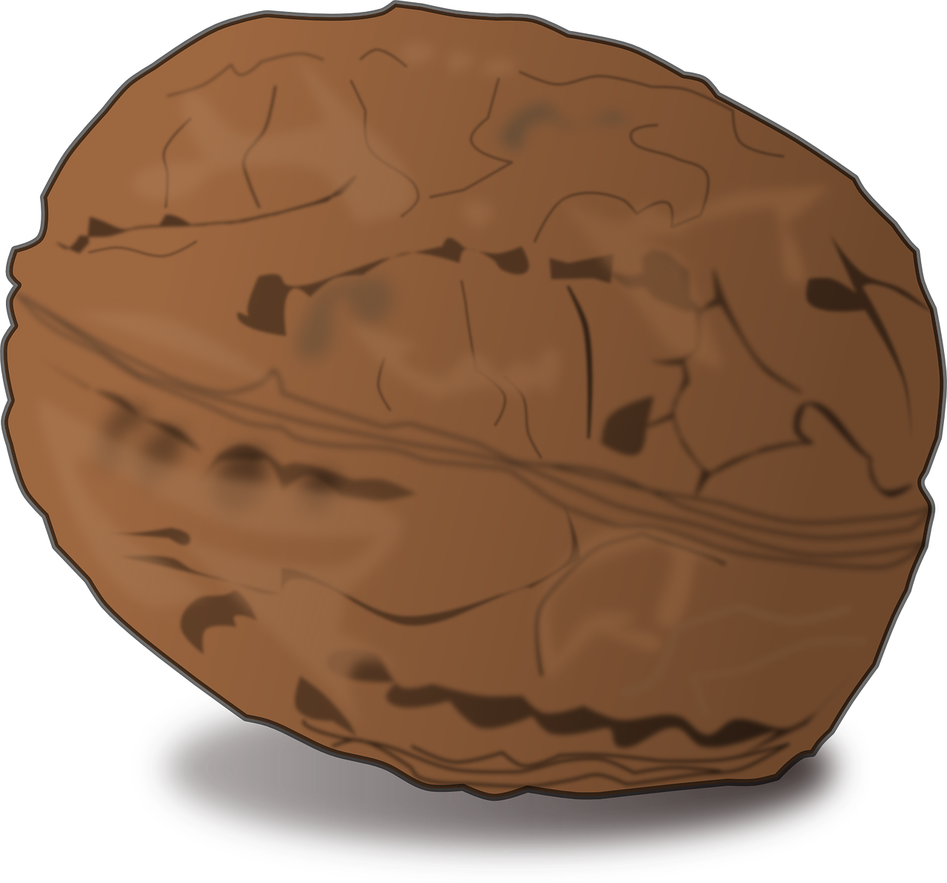
Sources of fat
Butter
Ghee
Milk
Yogurt
Nuts
Oils
Egg yolk

Slide 11
Vitamin
Vitamins are essential for growth and maintenance of our body.
Vitamin helps us to fight against infection.
There are different types of vitamins
Vitamin A
Vitamin B
Vitamin C
Vitamin D
Vitamin E
Vitamin K

Slide 12
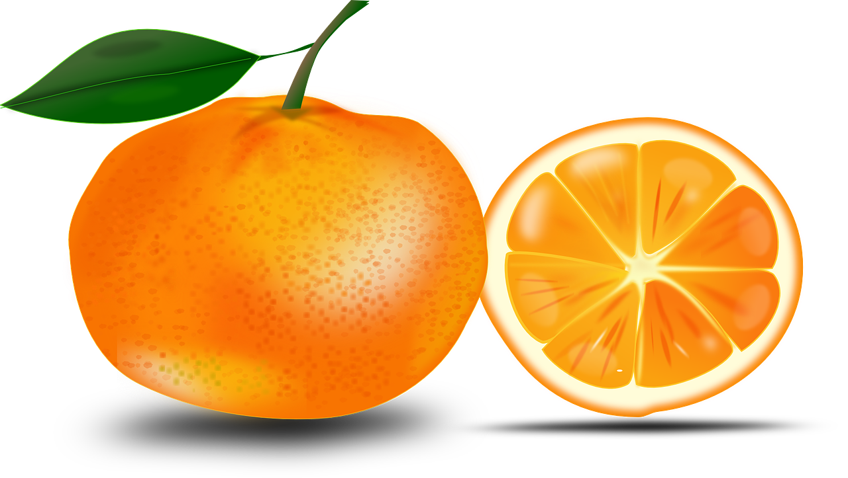
Sources of Vitamins
Vegetable
Fruits
Fish
Meat
Juices
Whole grains
Dairy products

Slide 13
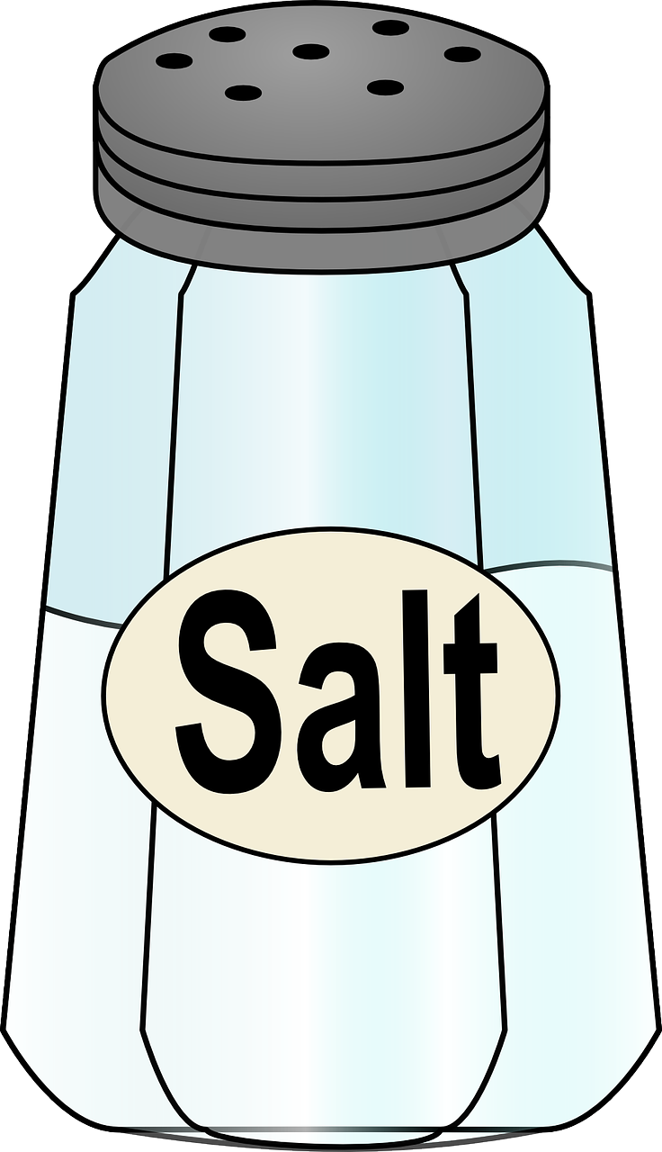
Minerals
Minerals are required for our body in small quantities.
Minerals help body to grow, develop and stay healthy.
Some common minerals
Iron
Iodine
Calcium
Phosphorus
Sodium
Potassium

Slide 14
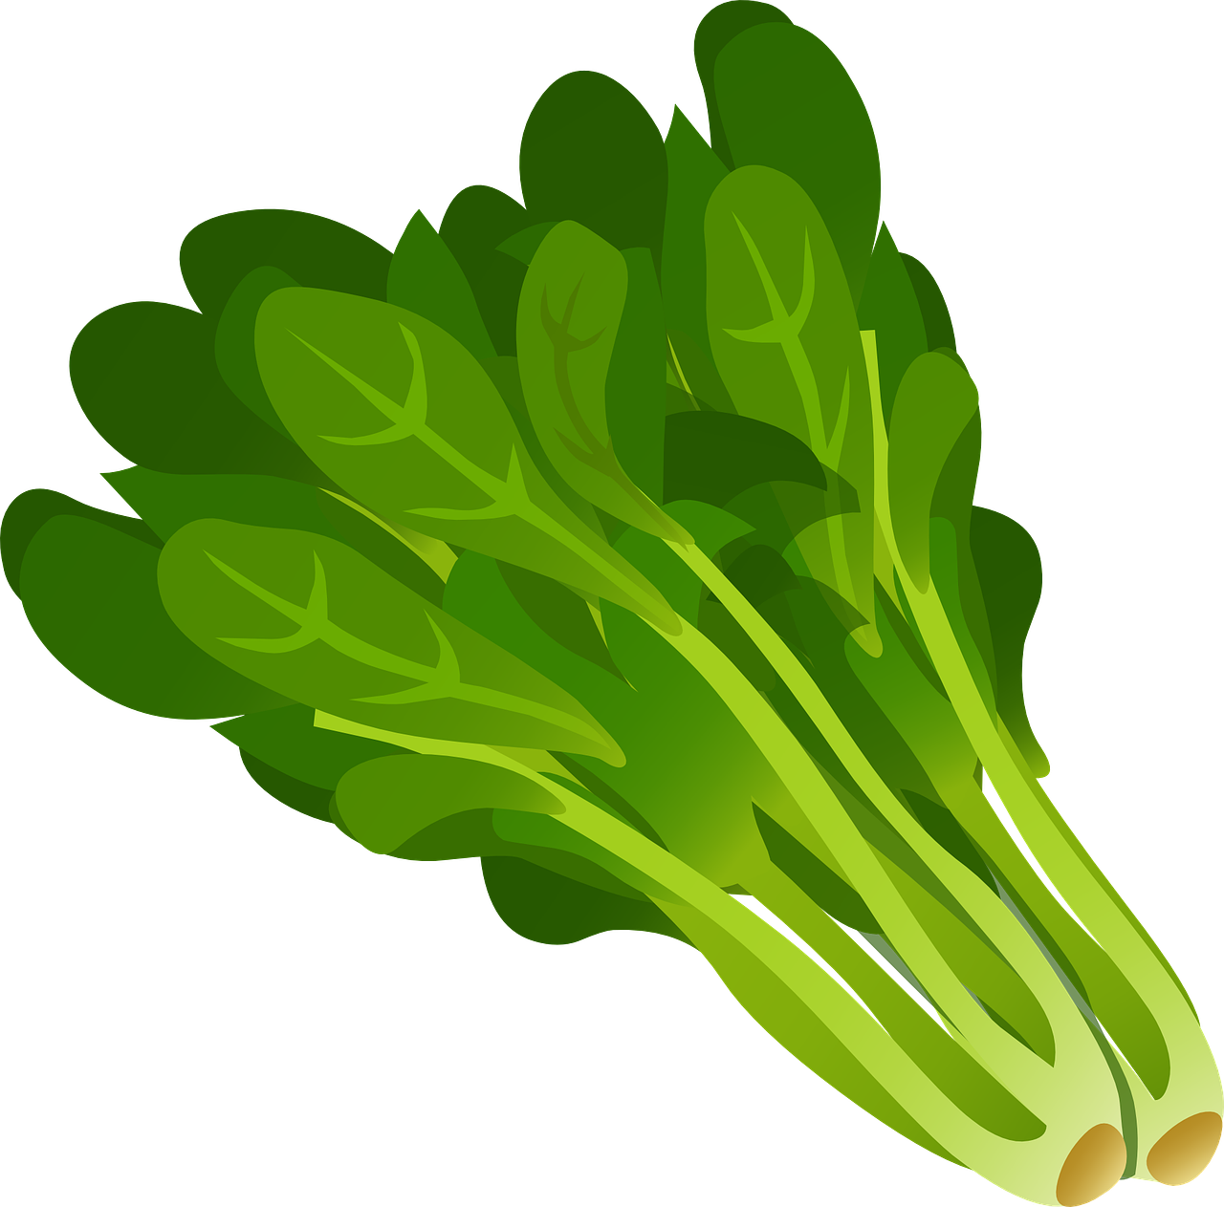
Sources of minerals
Salt
Leafy vegetables
Fruits
Legumes
Milk
Fish
Meat

