Slide 1
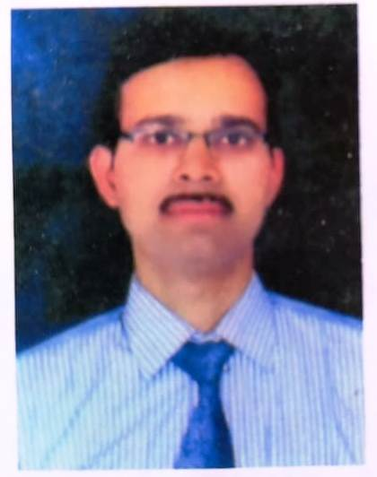
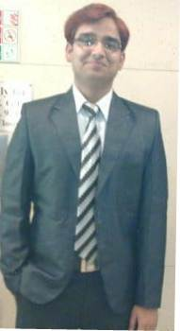
Prepared by
Prakash chandra bhatt
(astt.teacher-g.m.p.s.transit camp)
Umesh chandra bubari
(astt.teacher-g.p.s.dhauradam-2)

Slide 2

BODY MOVEMENTs

Slide 3


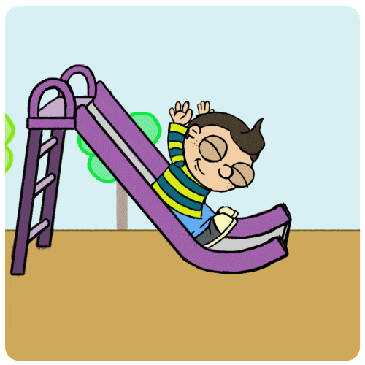
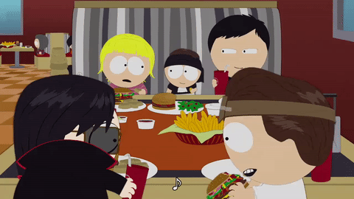

“HELLO STUDENTS” .Today We are going to learn about movements in our body You observe so many body movements during Playing, Eating Food And Running

Slide 4
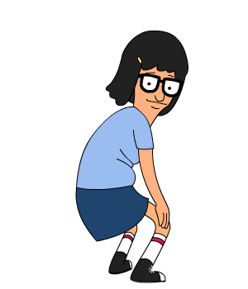
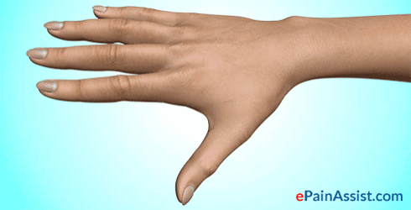

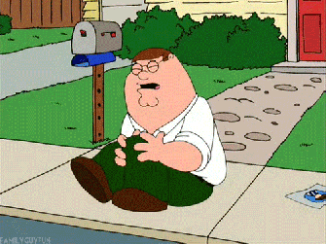
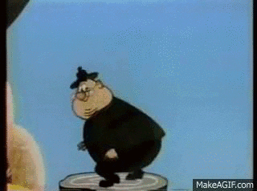
Movements in our body
NECK
KNEE, LEG.
HAND, FINGER
BACK.

Slide 5

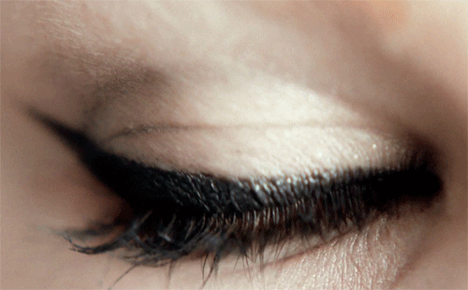
SOME BODY MOveMENTS IN STILL POSITIONS

Slide 6
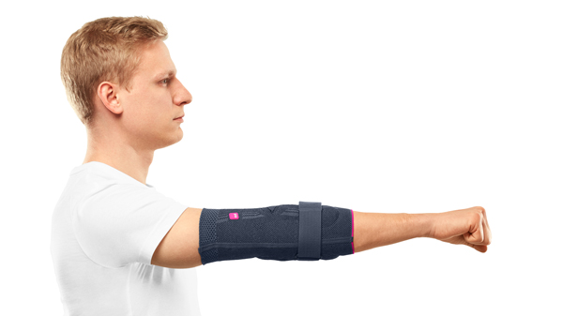
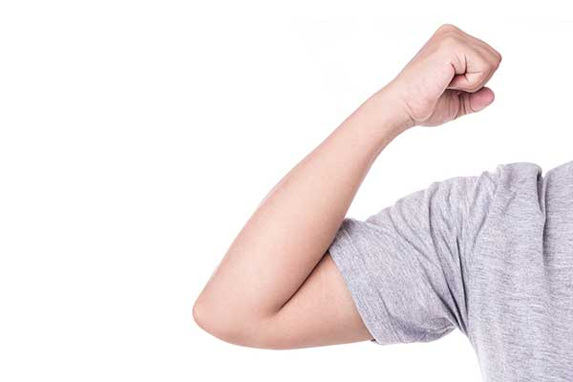
bend YOUR ARM

Slide 7
JOINTS
MOVABLE JOINTS
HINGE JOINT
PIVOT JOINT
IMMOVABLE JOINTS
FIXED JOINT
GLIDING JOINT
BALL AND SOCKET JOINT
CLICK BOXES TO SEE IMAGES

Slide 8
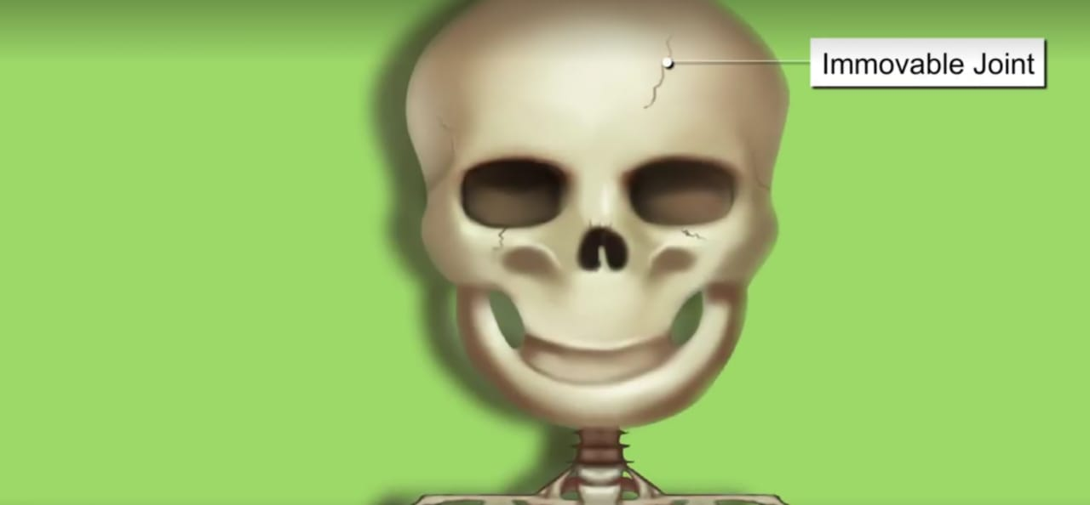
THE IMMOVABLE JOINTS ARE THOSE JOINTS THAT ALLOWES NO MOVEMENTS OF THE BODY PARTS. THESE ARE ALSO CALLED FIXED JOINTS.

Slide 9
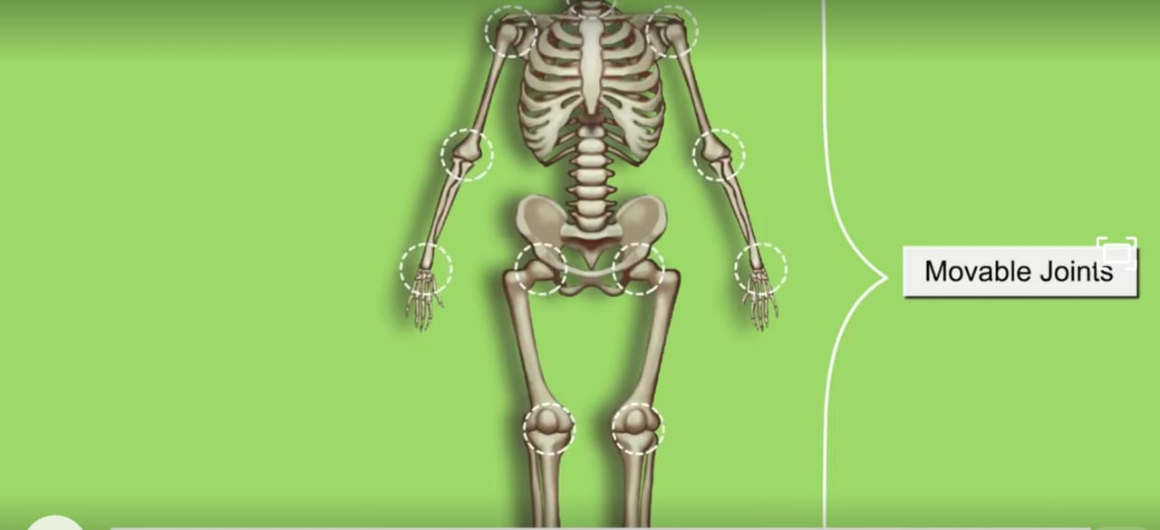
MOVEABLE JOINTS THAT HELP IN THE MOVEMENT OF THE BODY PARTS .

Slide 10
LET’S RECAP
HOW MANY TYPES OF IMMOVABLE JOINTS IN OUR BODY?
HOW MANY TYPES OF MOVABLE JOINTS IN OUR BODY ?
Click on the above questions,to see answer
Notes:
Click on the above question,to see answer

Slide 11
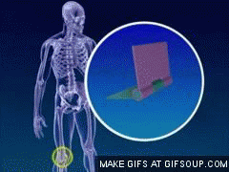
HINGE JOINTS

Slide 12
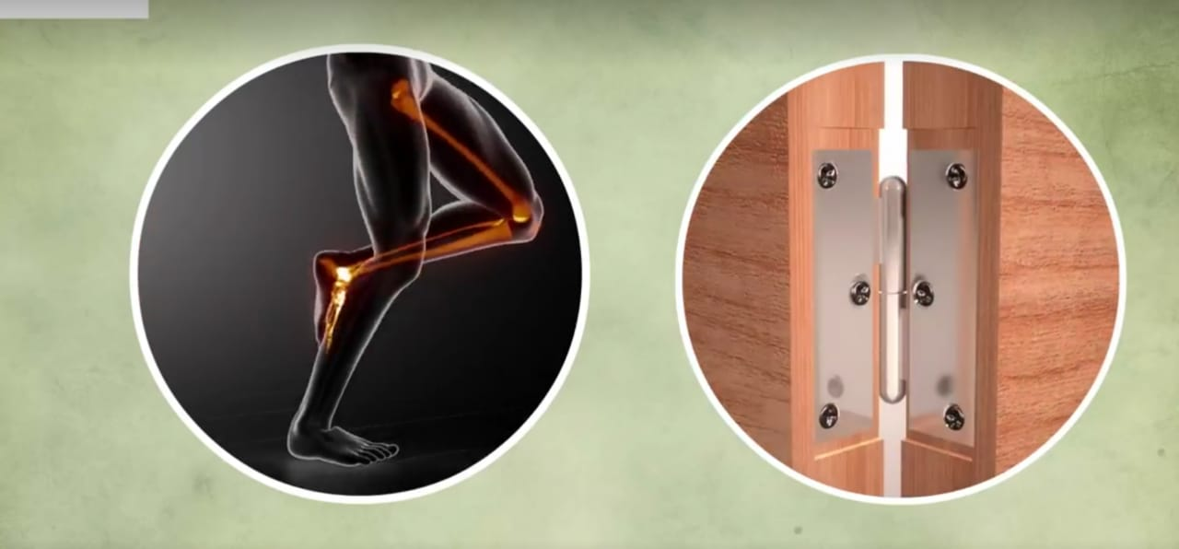
Open and close a door a few times. Observe the hinges of the door carefully. They allow the door to move back and forth.

Slide 13
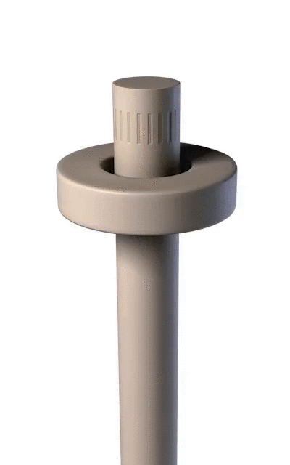
PIVOT JOINTS
THIS IS THE JOINTS IN WHICH ONE BONES FITS IN TO A RING FORMED BY THE OTHER BONE.IT ROTATES OVER THE PIVOT- LIKE END OF THE OTHER BONE.

Slide 14
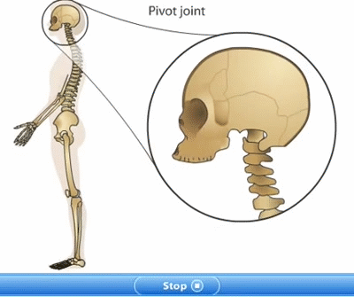

Slide 15
LET’S RECAP
KNEE JOINT IS AN EXAMPLE OF…..JOINT?
JOINT BETWEEN SKULL AND BACKBONE IS CALLED………..JOINT?
Click on the above questions to see answer

Slide 16
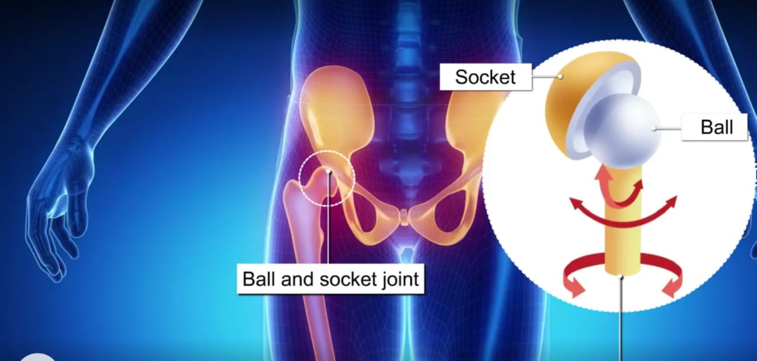
A JOINT IN WHICH A BALL MOVES WHTIIN A SOCKET SO AS TO ALLOW ROTATRY MOTION

Slide 17
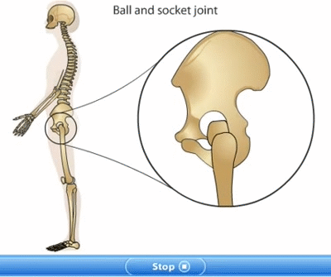

Slide 18
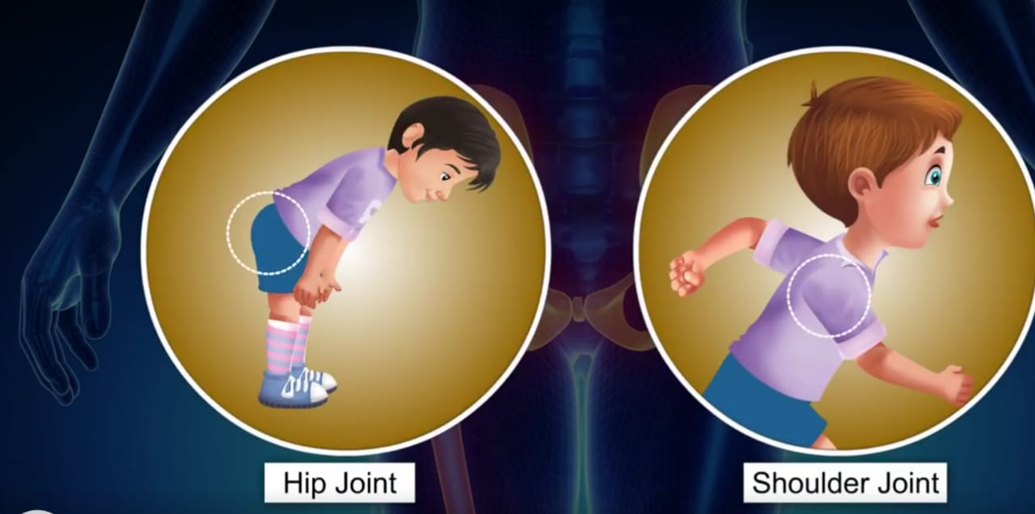

Slide 19
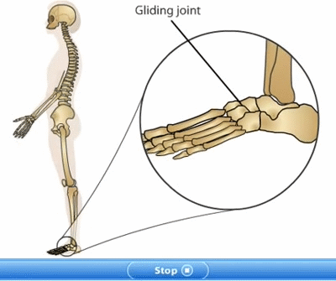
Gliding joints are joints between flat or nearly flat surfaces.

Slide 20
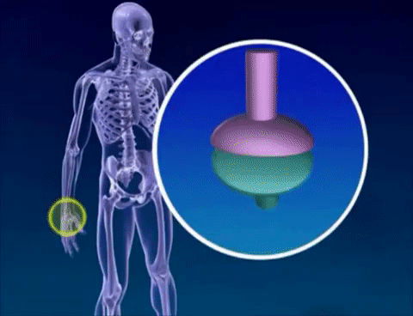
GLIDING JOINTS

Slide 21
TEST YOUR KNOWLEDGE
STATE WHETHER TRUE OR FALSE.
ALL LIVING ORGANISMS CAN MOVE THEIR OWN?
BONES CANNOT MOVE ON THEIR OWN?
BONES CANNOT JOIN WITH OTHER BONES?
A SINGLE MUSCLE CAN MOVE A BONE IN DIFFERENT DIRECTIONS?
ONLY ANIMALS WITH BOTH BONES AND MUSCLES CAN MOVE ?

Slide 22
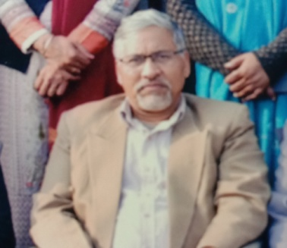
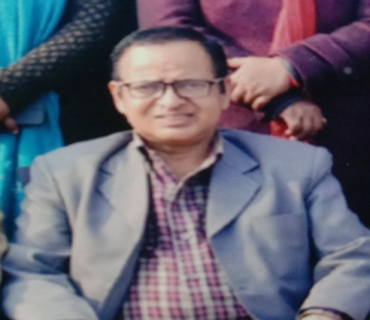
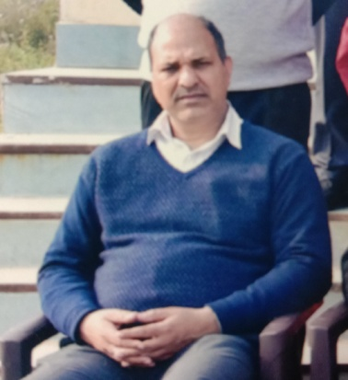
District Education & Training Institute
Udham Singh Nagar
Motivation – Mr. Dharam Singh Rawat
(D.E.I.T. Principal)
Direction – Mr. Mohan Singh Rawat
(H.O.D.- E.T. Department)
Coordination – Mr. B.P. Joshi
(Coordinator - E.T. Department)

Slide 23


Slide 24

SEE YOUR ANSWER
ANS-1
THERE ARE FOUR TYPES IMMOVABLE JOINTS IN OUR BODY I.E PIVOT, HINGE,GLINDER AND BALL AND SOCKET JOINT.

Slide 25
SEE YOUR ANSWER
ANS-1:
ONLY ONE TYPE OF IMMOVABLE JOINT IN OUR BODY, I.E FIXED JOINT.

